Slide 1
Bond 2020
Community Update
Neal Elementary
Edison High School
Feb. 6, 2025

Slide 2

Purpose of Today’s Meeting
Bond 2020 Program Update
Major renovation updates for:
  Neal Elementary
  Edison High School
Facility Condition Assessment and master planning

Slide 3
Bond 2020 Approval
In November 2020, voters approved two propositions totaling $1.3 billion:
PROP A
$1.21 billion for:
Campus renovations/upgrades, including HVAC upgrades
Security upgrades at all schools
Replacement of air-conditioning chillers more than 15 years old at schools not receiving major renovations
New school models
PROP B
$90 million for technology upgrades for all schools

Slide 4
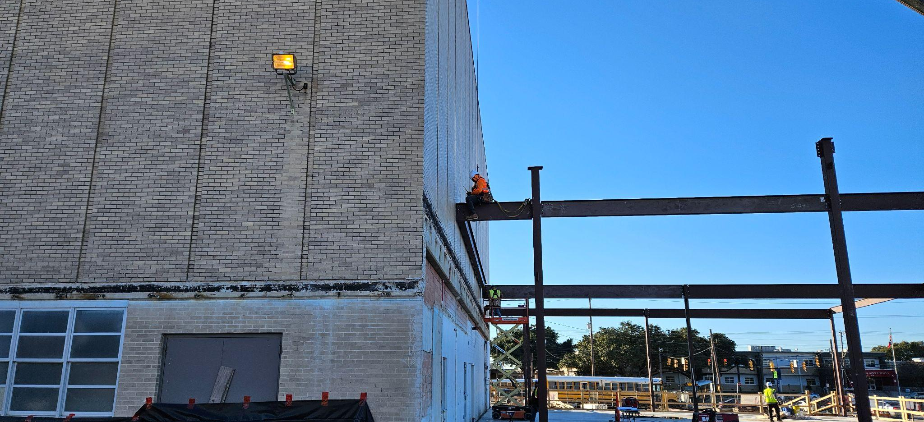
Bond 2020 Planning
Renovation projects were planned pre-pandemic
using standard estimates
of 4%-5% for inflation

Slide 5
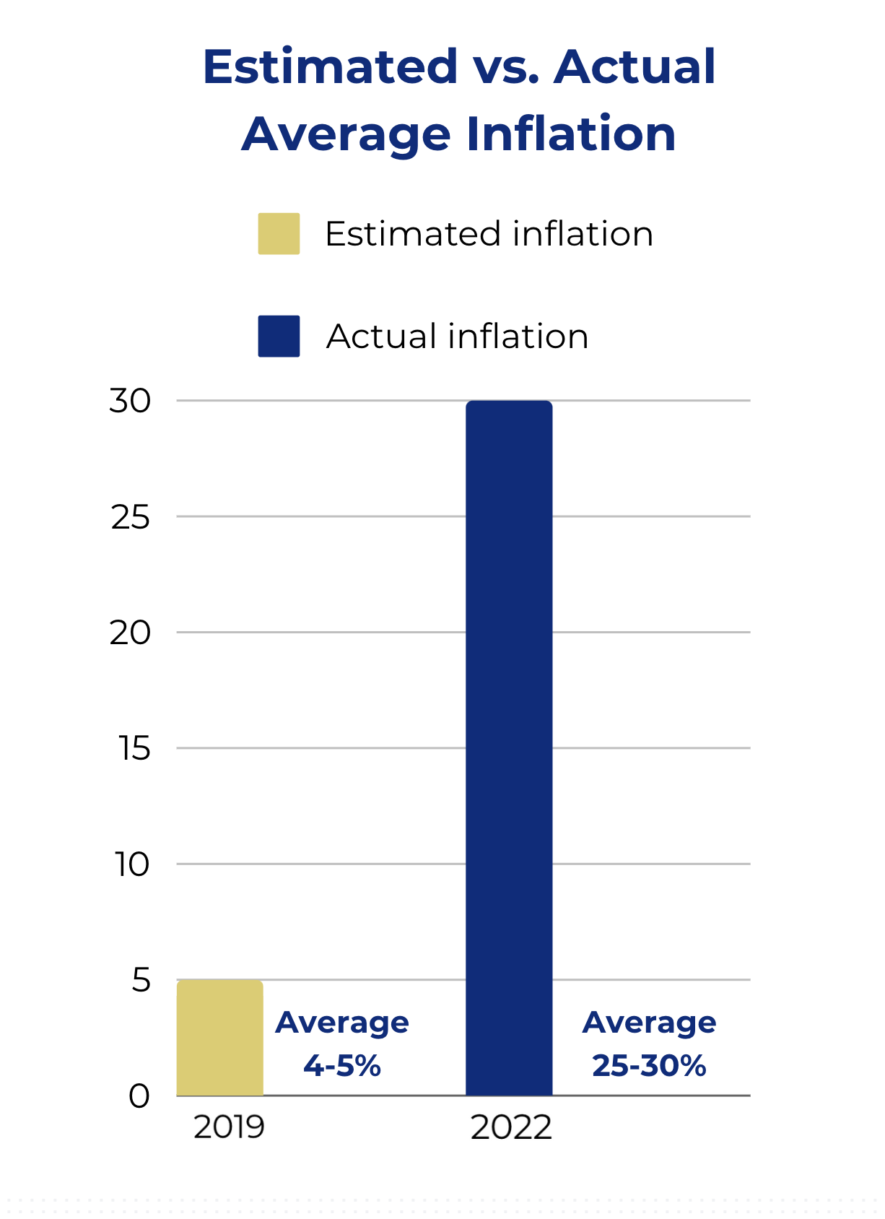
Pandemic Impacts
And then the global pandemic
hit, bringing with it significant construction pressures:
Unprecedented inflation
  Average of 25-30%
  Preliminary estimates for all projects came in over budget
Supply chain issues
Labor shortages

Slide 6

District Response
A tremendous amount of work went into salvaging Bond 2020:
Bond expenses examined at a program and a project level to identify savings
A number of program-wide cost-saving measures implemented
  Example: project start dates staggered through phasing
Every major renovation project
reviewed to get as close to budget as possible

Slide 7
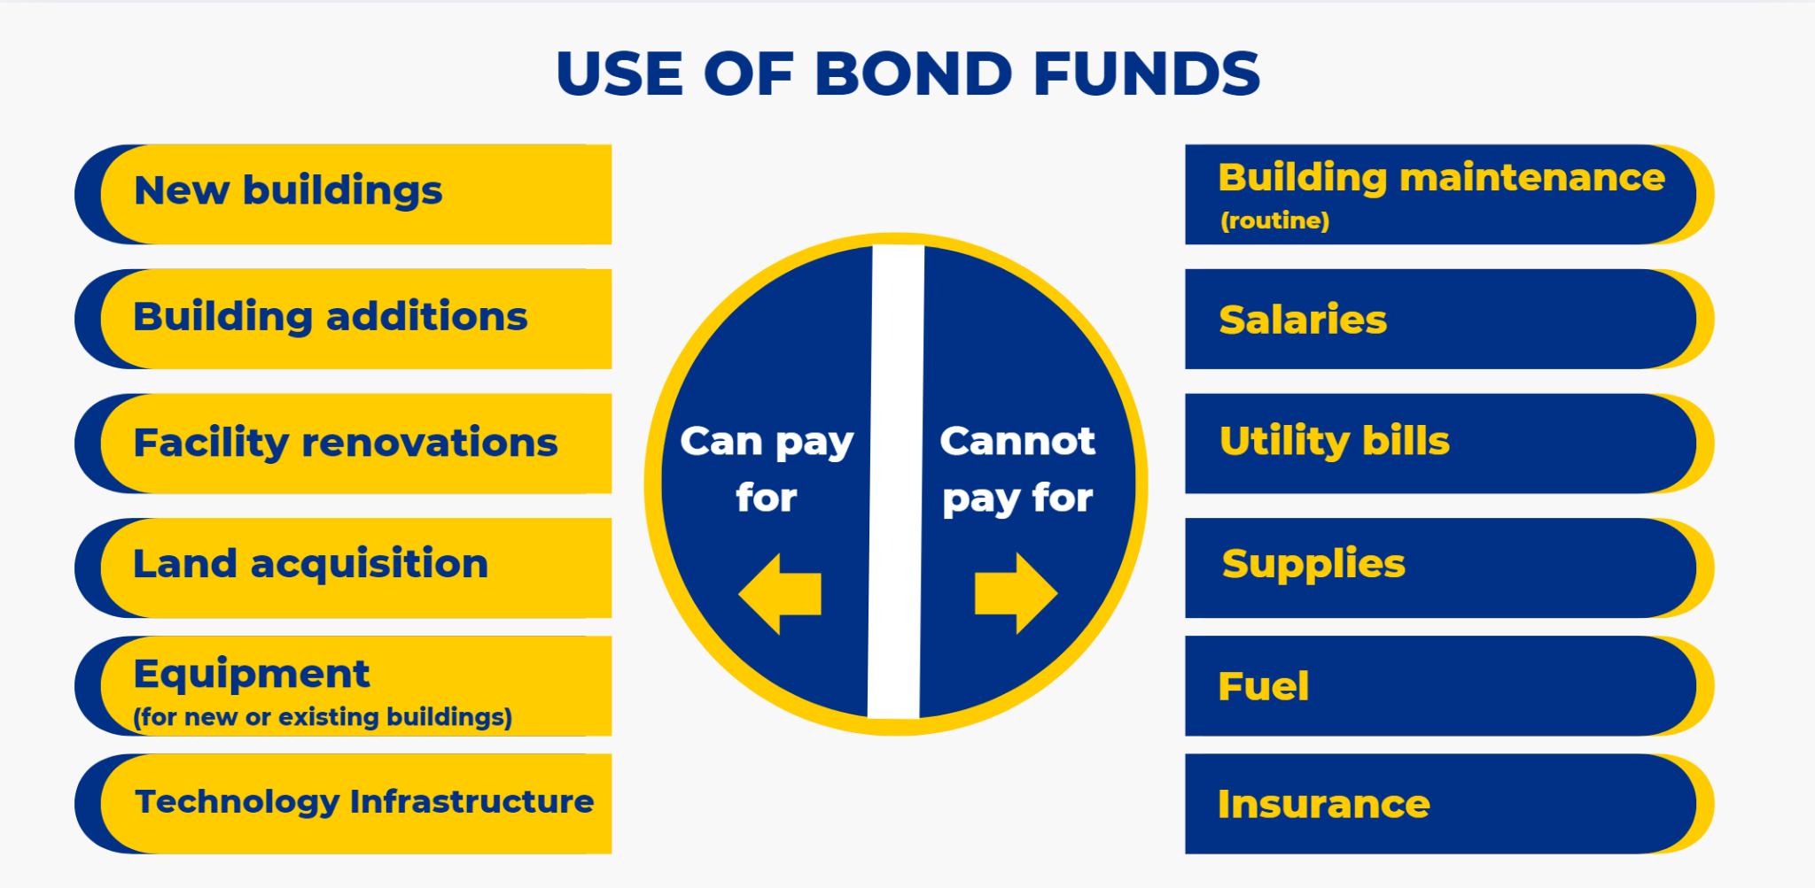
How Can Bond Funds Be Used?

Slide 8

Rightsizing Impact
In 2023, the Board of Trustees voted on a plan to consolidate SAISD schools
Ripple effect on the bond program
7 of the campuses to be consolidated were slated for renovations (leaving 29 major renovations projects)
Receiving campuses had immediate needs to accommodate larger student populations

Slide 9

Funds From Canceled Bond Projects
Funds returned to the overall bond program for areas of critical need across the district, including at campuses receiving students through Rightsizing
The Bond 2020 Citizens Advisory Committee supported the use of returned bond funds for the following priority areas:
HVAC
Security upgrades
Restoration of scope to address critical needs

Slide 10
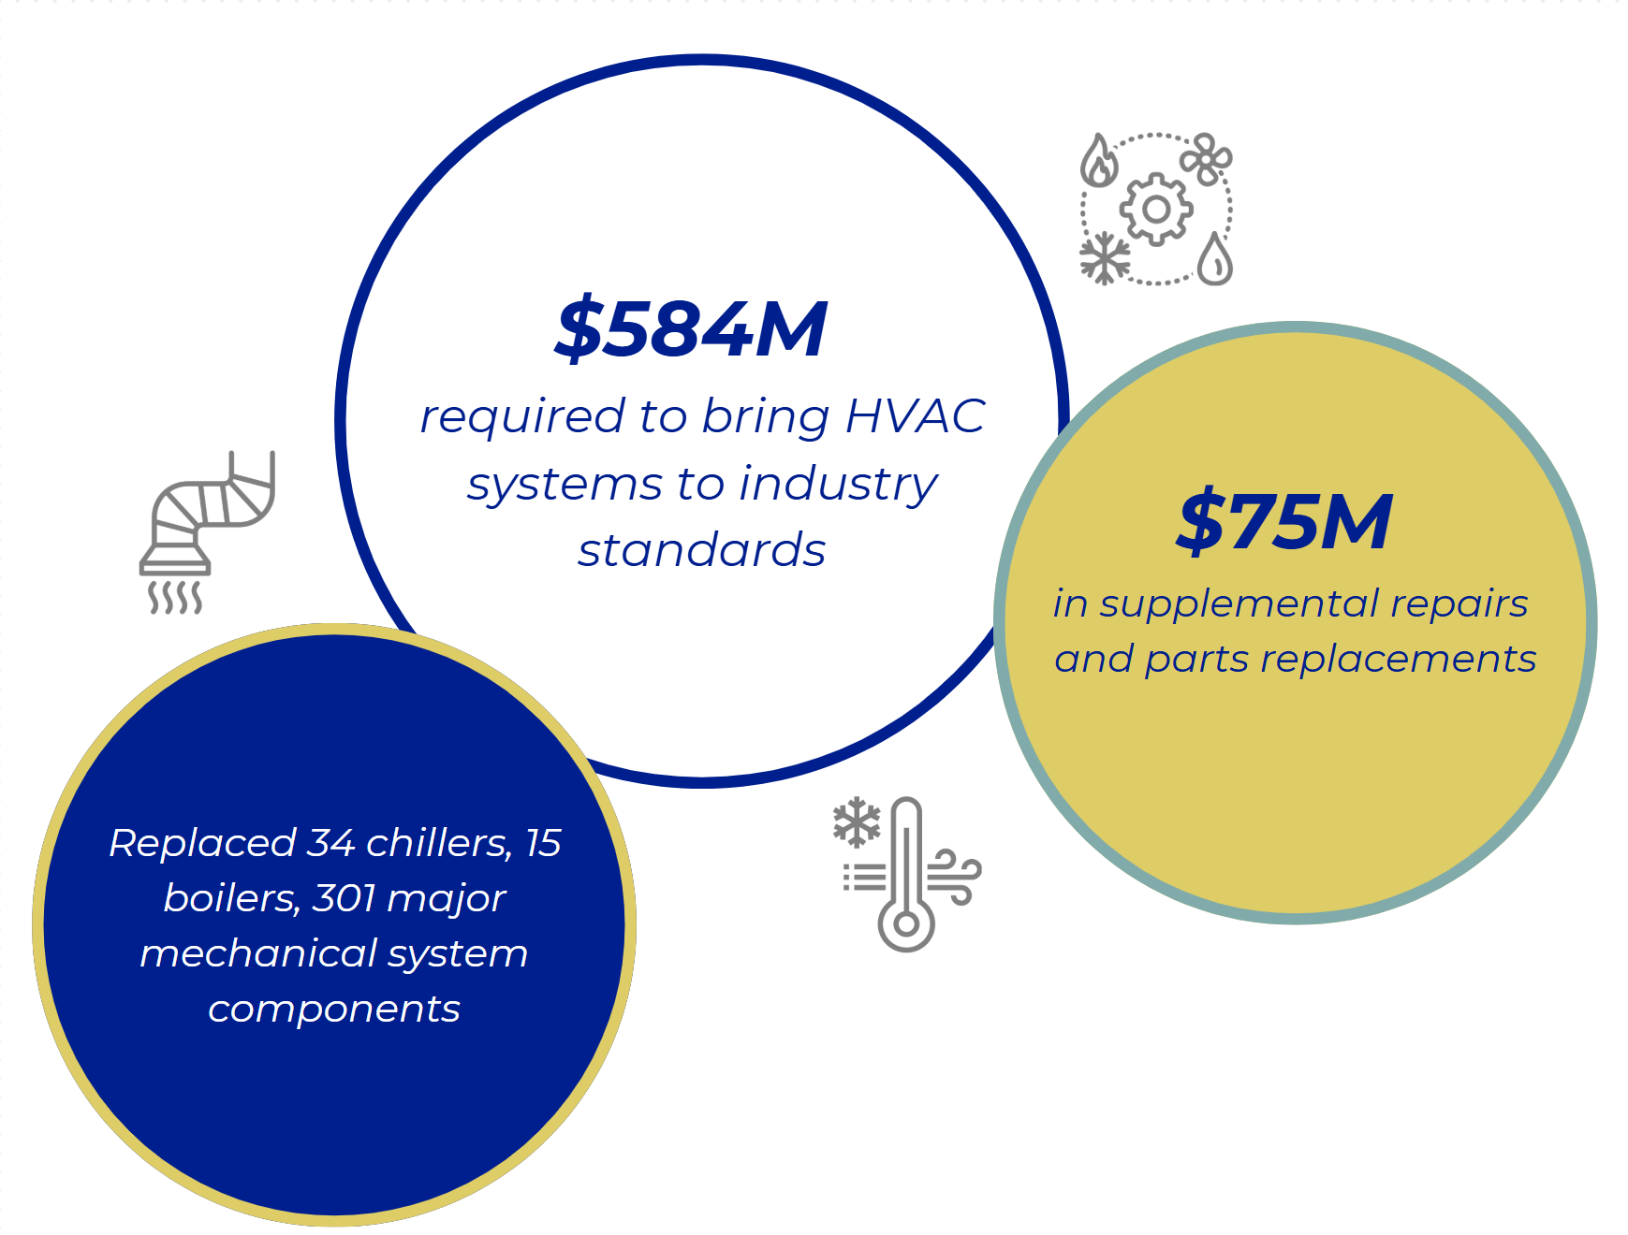
Significant HVAC Needs

Slide 11

Where We Are Today

Slide 12

Breakdown of Project Costs

Slide 13
Edison HS: Current Project Scope & Budget
Budget Allocation*: $32.2 million
Scope:
Renovate classrooms on the first and second floors
New library with media labs and upgraded technology
Upgraded technology and security
Roof improvements
Replace past life or non functional HVAC components
New baseball and softball fields
Upgrade parking lot with perimeter security fencing
Targeted completion:
Spring 2025
*Includes architectural, engineering, surveys, permits, construction costs and FF&E

Slide 14
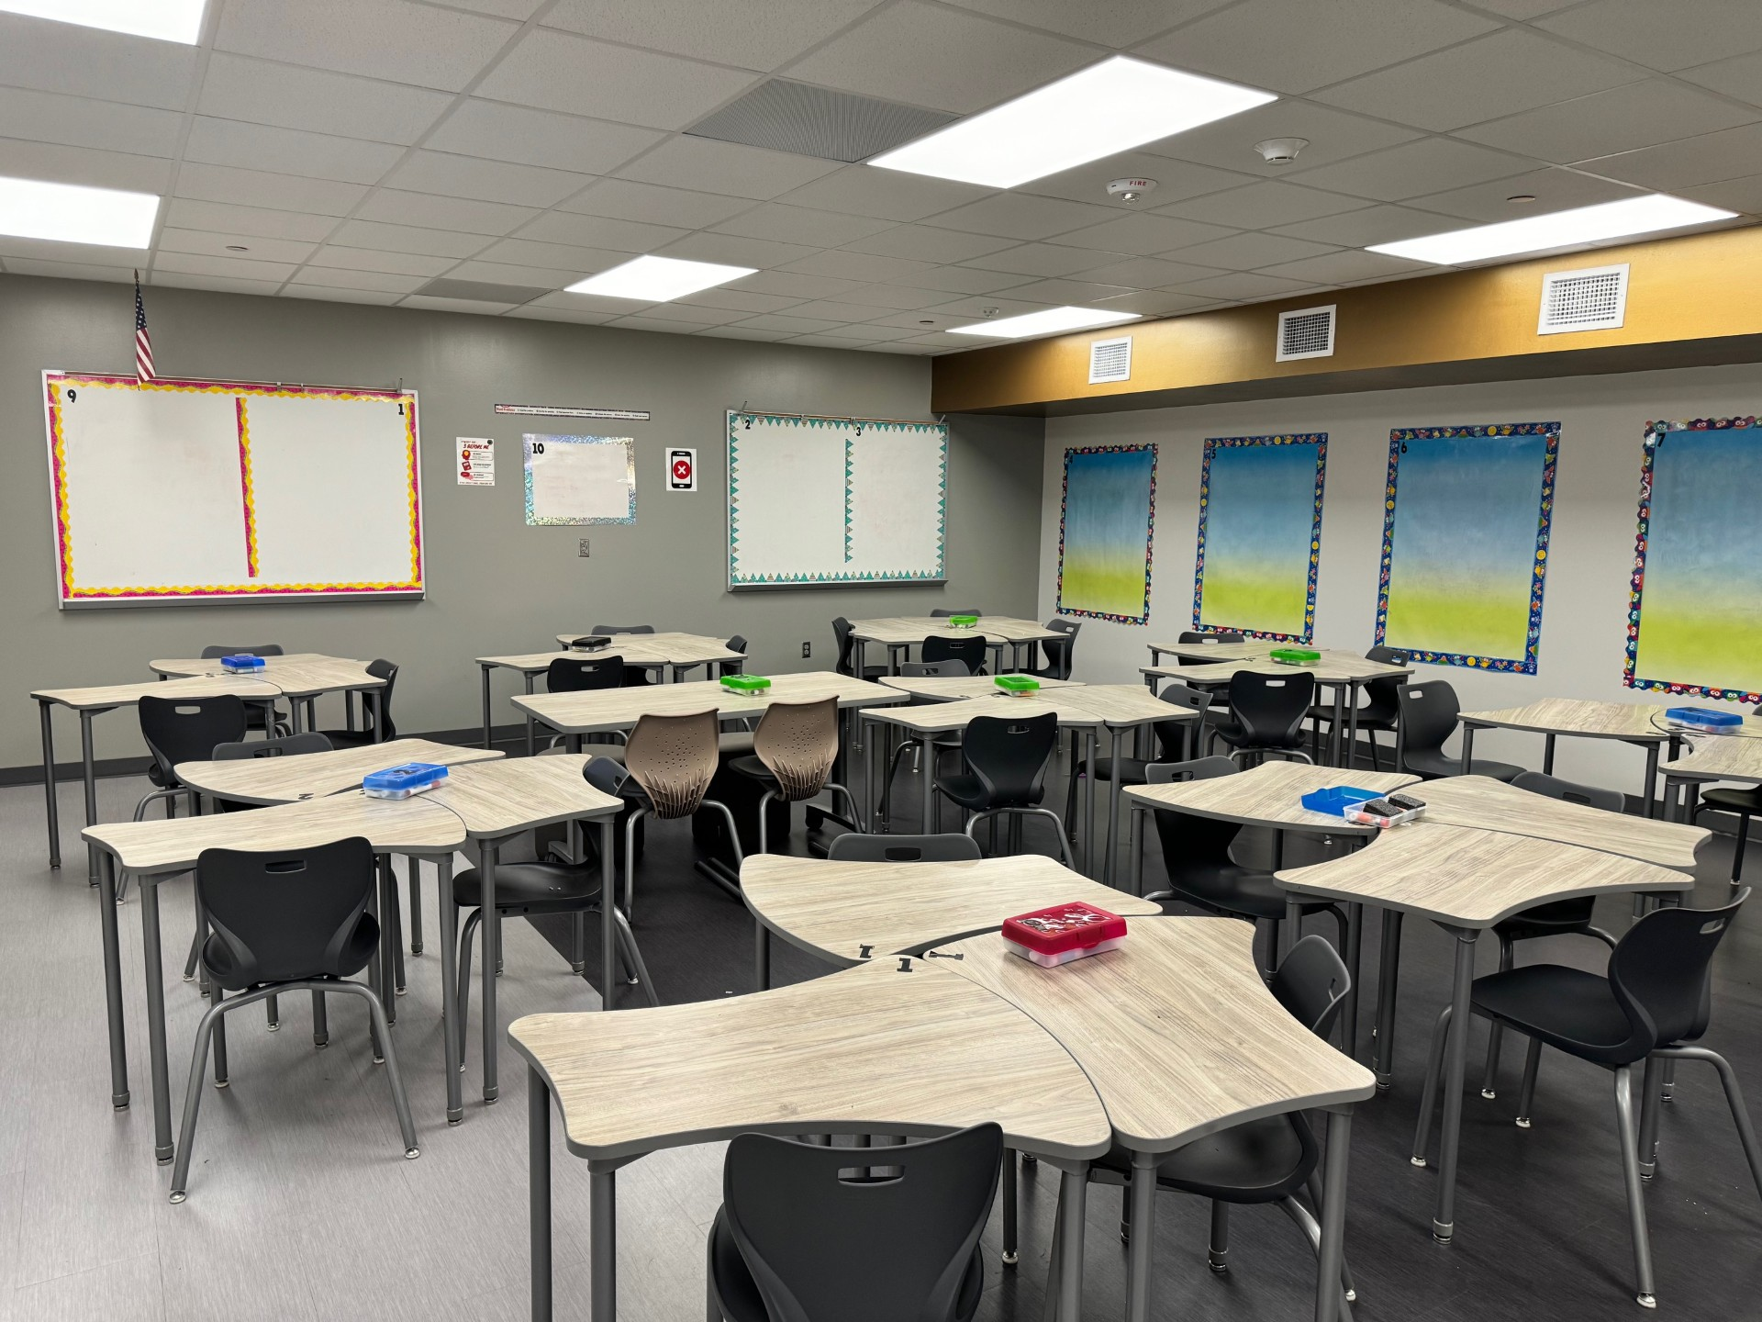
Edison HS Project Status
Improved parking lot and security fencing completed
First- and second-floor classroom renovations completed in main academic building
New library on second floor currently under construction

Slide 15
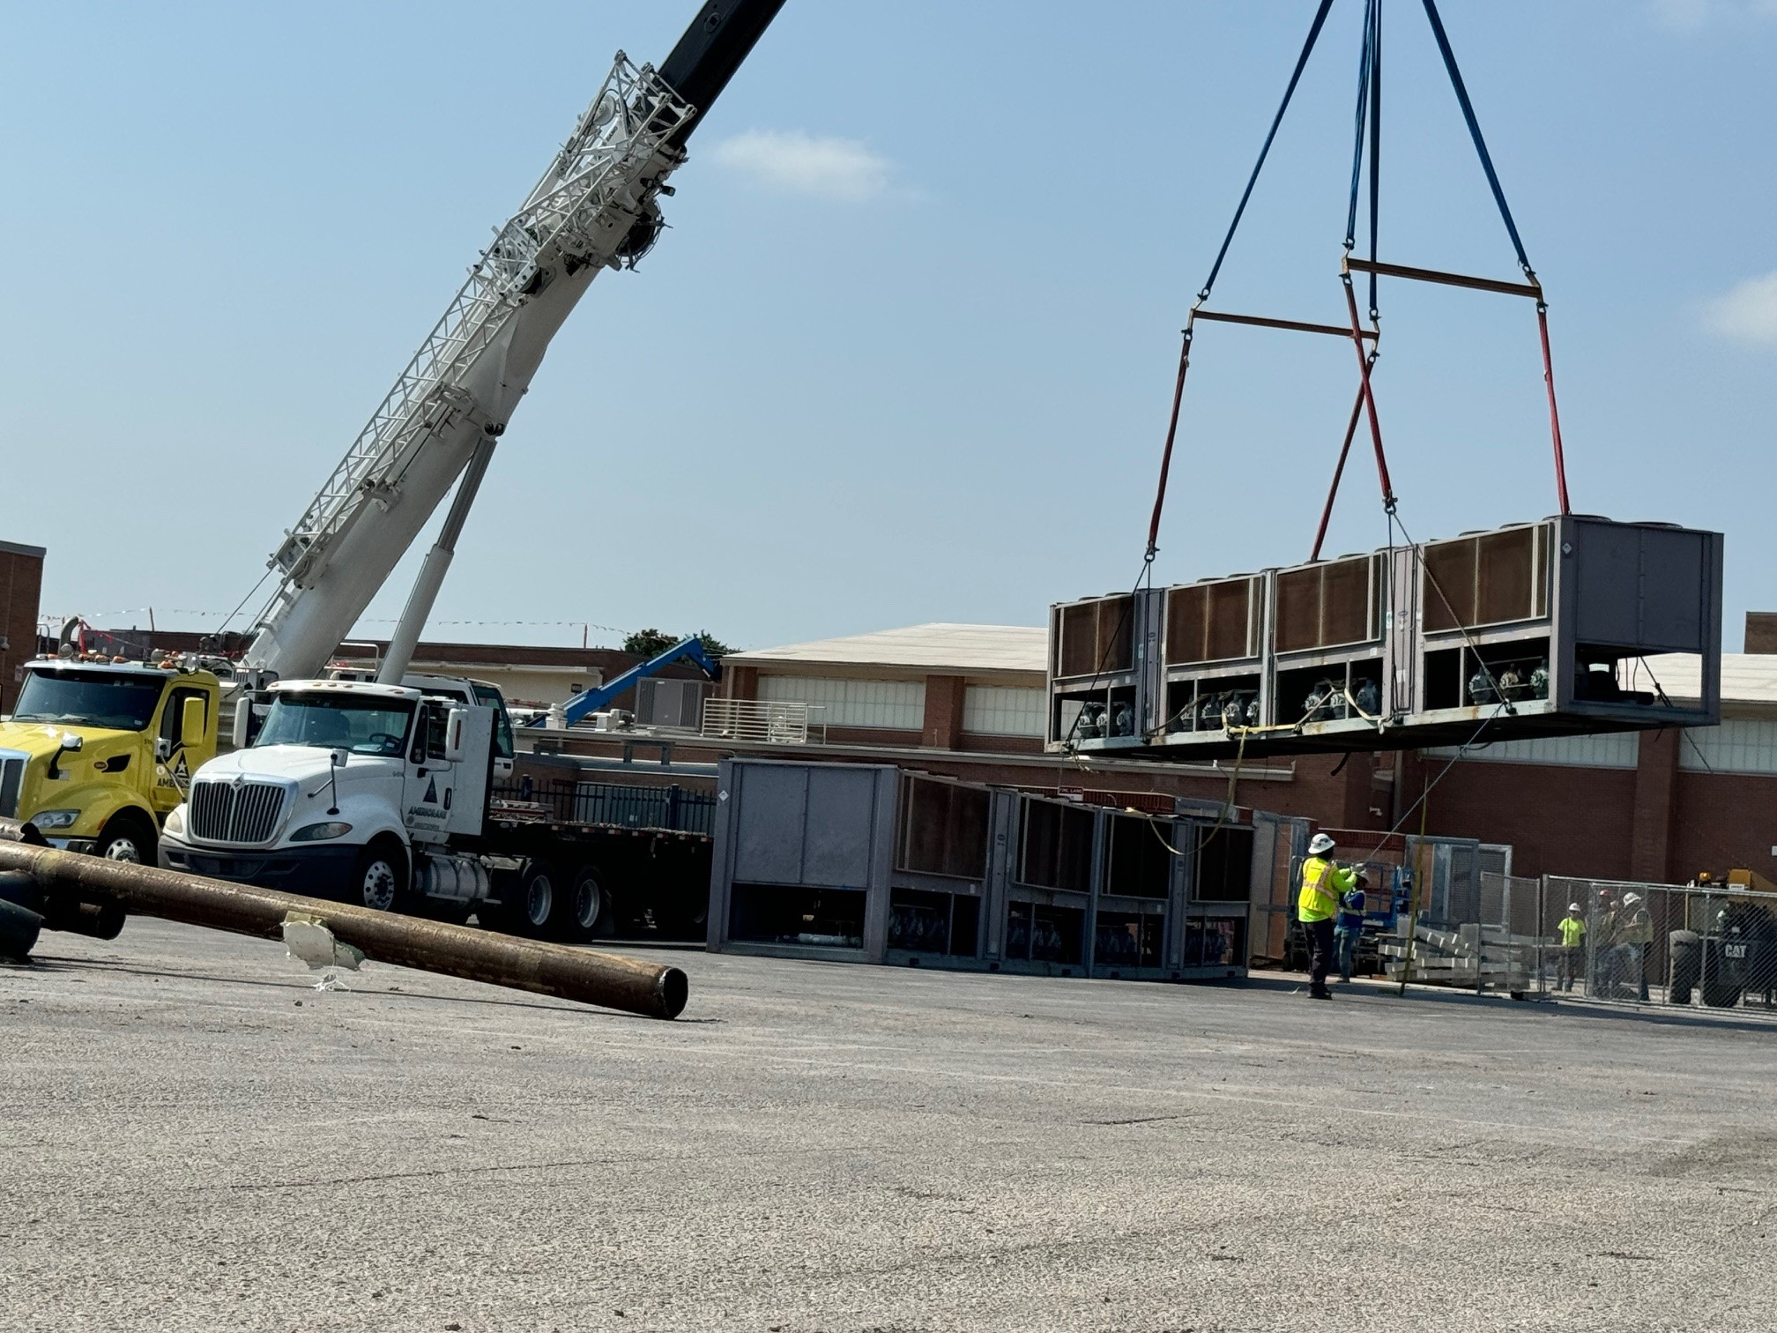
Edison HS Project Status
HVAC improvements completed, including 2 new chillers
Portion of roof in main academic building replaced
Technology and security upgrades installed

Slide 16
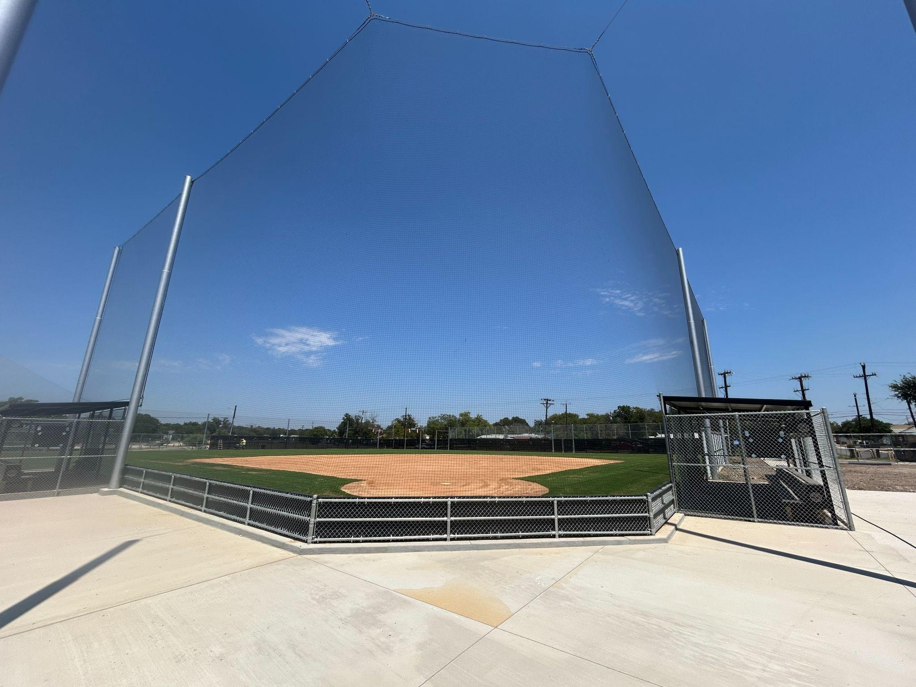
Edison HS Project Status
New baseball and softball fields completed in the Fall
New dugouts, bullpen, and batting cages

Slide 17
Neal ES: Current Project Scope & Budget
Budget Allocation*: $26.7 million
*Includes architectural, engineering, surveys, permits, construction costs and FF&E
Scope:
Overhaul or replace all classrooms and science labs
Overhaul or replace special education classrooms
Renovate the gym and physical education support spaces
Overhaul or replace student dining and kitchen
Overhaul main office and main entrance to include secured vestibule
Replace old exterior windows with new energy efficient windows in spaces receiving renovations
Complete overhaul and update to mechanical systems to the latest energy efficiency and indoor air quality standards
HVAC installation/upgrades in new/renovated areas of the school
Add or replace outdoor learning opportunities
Re-pave and re-surface parking lots and driveways, and add a new bus loop
Add, replace, and/or repair existing playground equipment

Slide 18
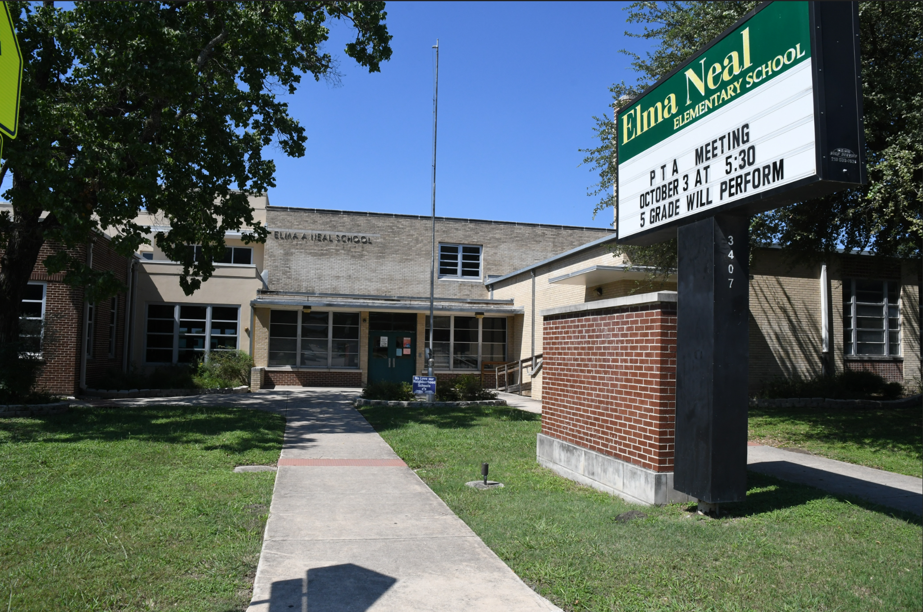
Neal ES Project Status
Neal ES included in Phase 3
Most Phase 3 projects in Design Development Phase
Construction estimates for Neal and other Phase 3 projects exceed project budget
As we review Phase 3 projects, key factors to consider include next round of Rightsizing and SAISD Master Plan 2045

Slide 19

Next Round of Rightsizing
In May 2024, the Board of Trustees requested recommendations for next round of Rightsizing
SAISD still has more schools than it needs for current student population of about 44,000
Kicking off Master Plan 2045 to guide future downsizing efforts

Slide 20
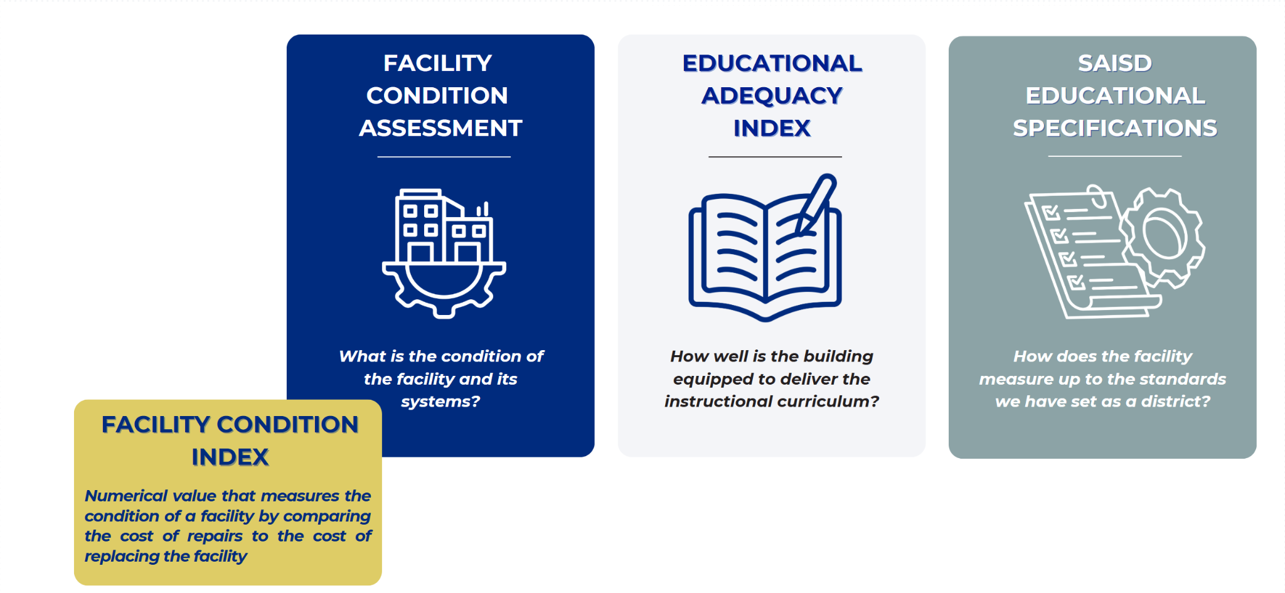
About the Master Plan
Master Plan 2045 will provide significant data for each SAISD facility

Slide 21

Next Steps
Kick off the facility master planning process to chart a new way forward for facilities in SAISD
Capital Development & Construction Services will be following up with Neal principal to discuss formation of Project Advisory Team (PAT).

Slide 22
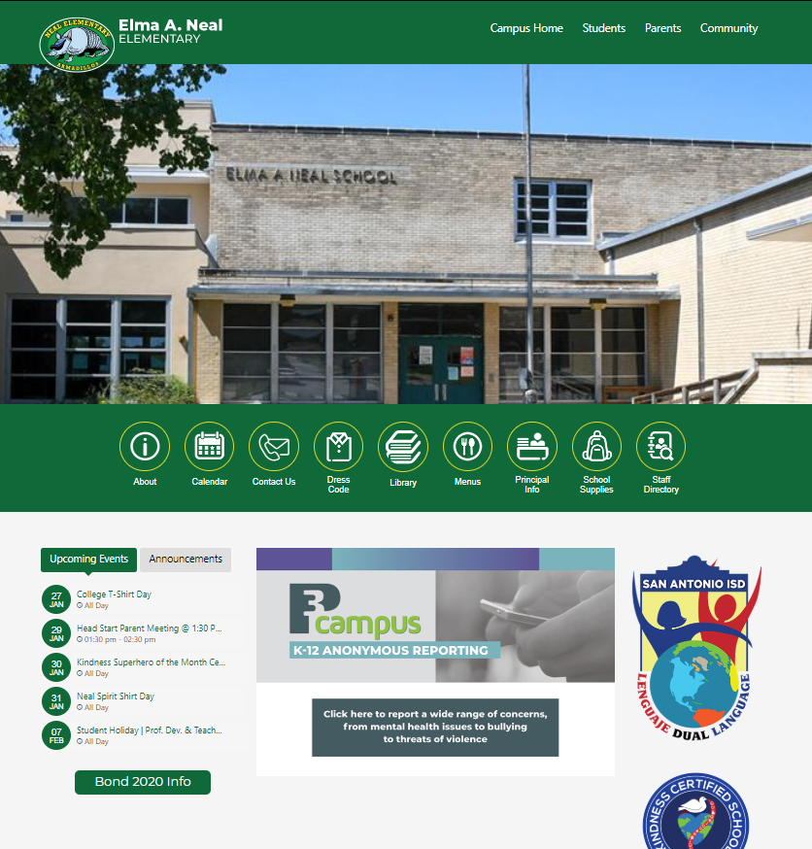
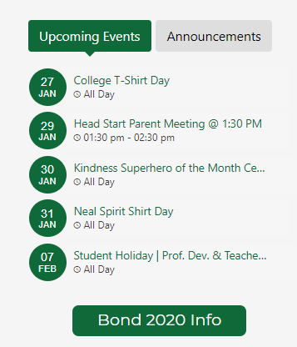




Bond Update & News
Bond.saisd.net
For individual project updates, upcoming events, and more
Campus website
Quick link to your school’s bond page via your campus homepage
Social media
Follow SanAntonioISD on Facebook, Instagram, and LinkedIn for bond progress and event info

Slide 23

Questions

